Slide 1

18AIC301J: DEEP LEARNING TECHNIQUES
B. Tech in ARTIFICIAL INTELLIGENCE, 5th semester
Section: A, slot:D
Academic Year: 2023-24

Slide 2
Unit-1
Biological neuron
Motivation from biological neuron
McCulloch Pitts Neuron
Thresholding logic
Perceptron
Perceptron learning algorithm
Apply MP Neuron and perceptron to solve a binary classification problem
Proof of convergen_{CC}ce of Perceptron learning algorithm
Network of perceptrons
Activation functions- Sigmoid, tanh, ReLU, leaky ReLU
Sigmoid neuron
Gradient descent learning algorithm
Representation power of multilayer Network of Sigmoid Neurons
Apply sigmoid neuron to solve a real-world classification / regression problem
Representation power of function: Complex functions in real world examples
Feedforward Neural Networks
Learning parameters, output and loss functions of FFN Networks
Backpropagation learning algorithm
Applying chain rule across in a neural network
Computing partial derivatives w.r.t a weight
Build a FFN Network to solve a Multi- class classification problem

Slide 3
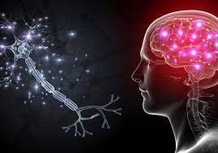
Building Blocks of a Neural Networks
Neurons

Slide 4
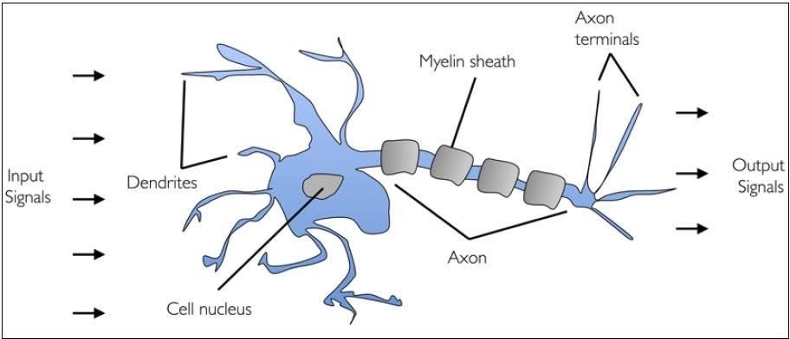
Biological Neural Networks
Dendrites: nerve fibres carrying electrical signals to the cell Cell body: computes a non-linear function of its inputs
Axon: single long fiber that carries the electrical signal from the cell body to other neurons
Synapse: the point of contact between the axon of one cell and the dendrite of
another, regulating a chemical connection whose strength affects the input to the cell.

Slide 5
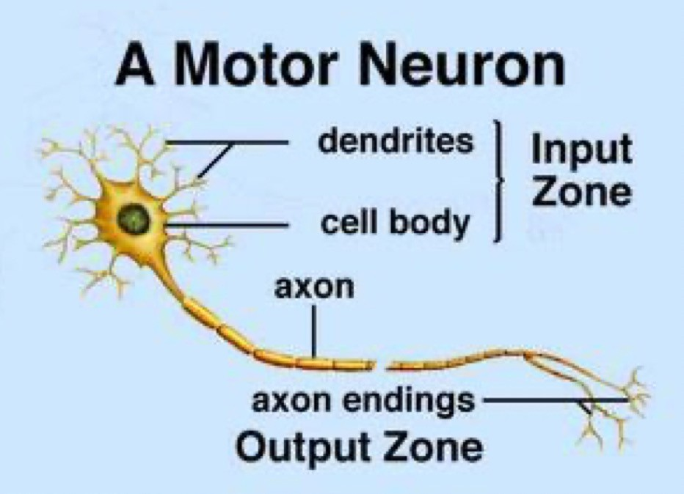
Biological Neural Networks
A human brain has billions of neurons.
Neurons are interconnected nerve cells in the human brain that are involved in processing and transmitting chemical and electrical signals.
A biological neuron has three types of main components; dendrites, soma (or cell body) and axon.
Dendrites are branches that receive information from other neurons.
The soma, sums the incoming signals. When sufficient input is received, the cell fires; that is it transmit a signal over its axon to other cells.

Slide 6
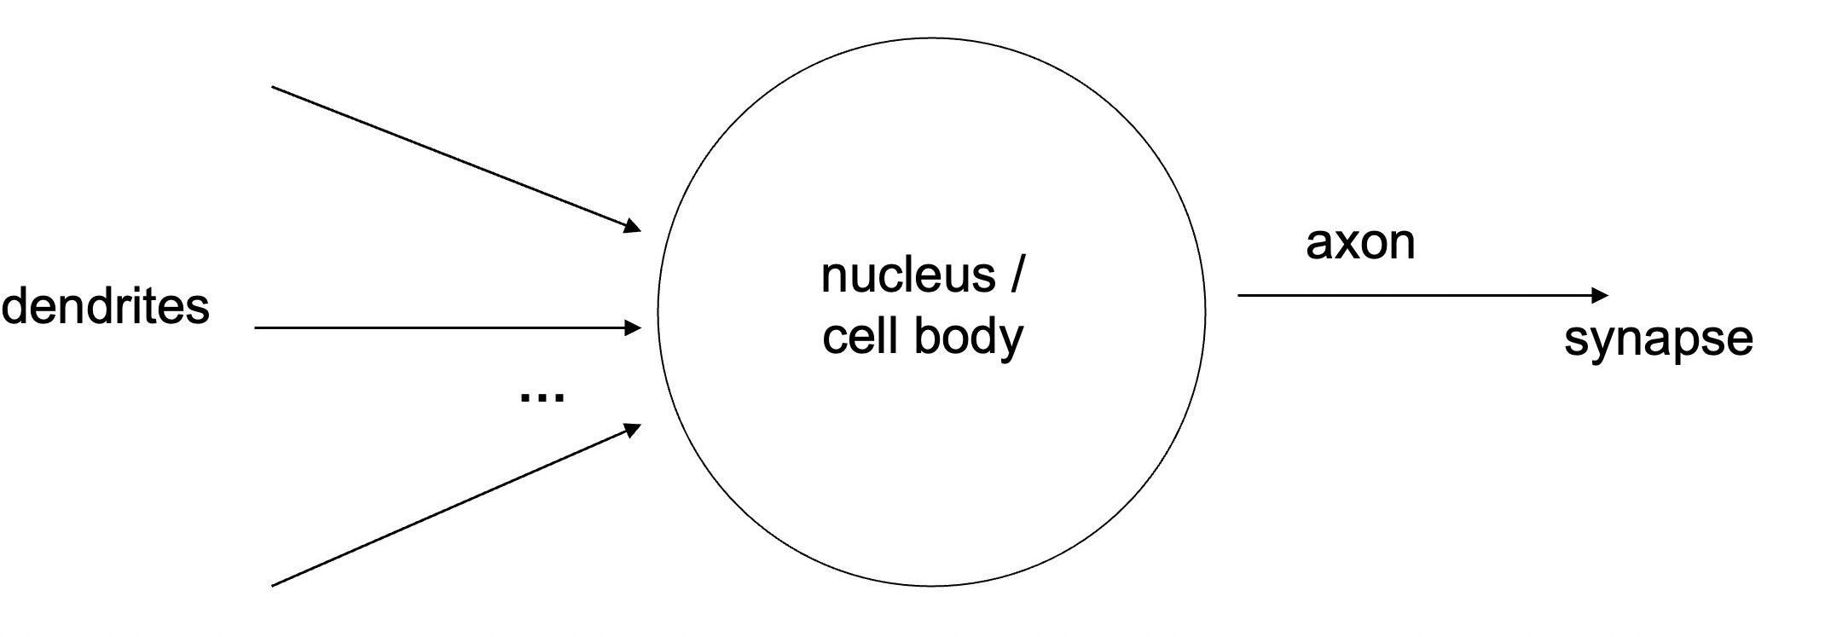
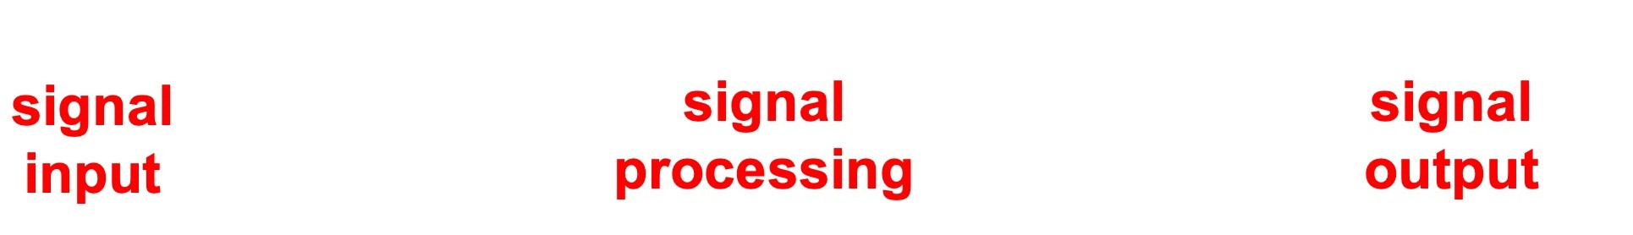
Structure of a Biological Neuron

Slide 7
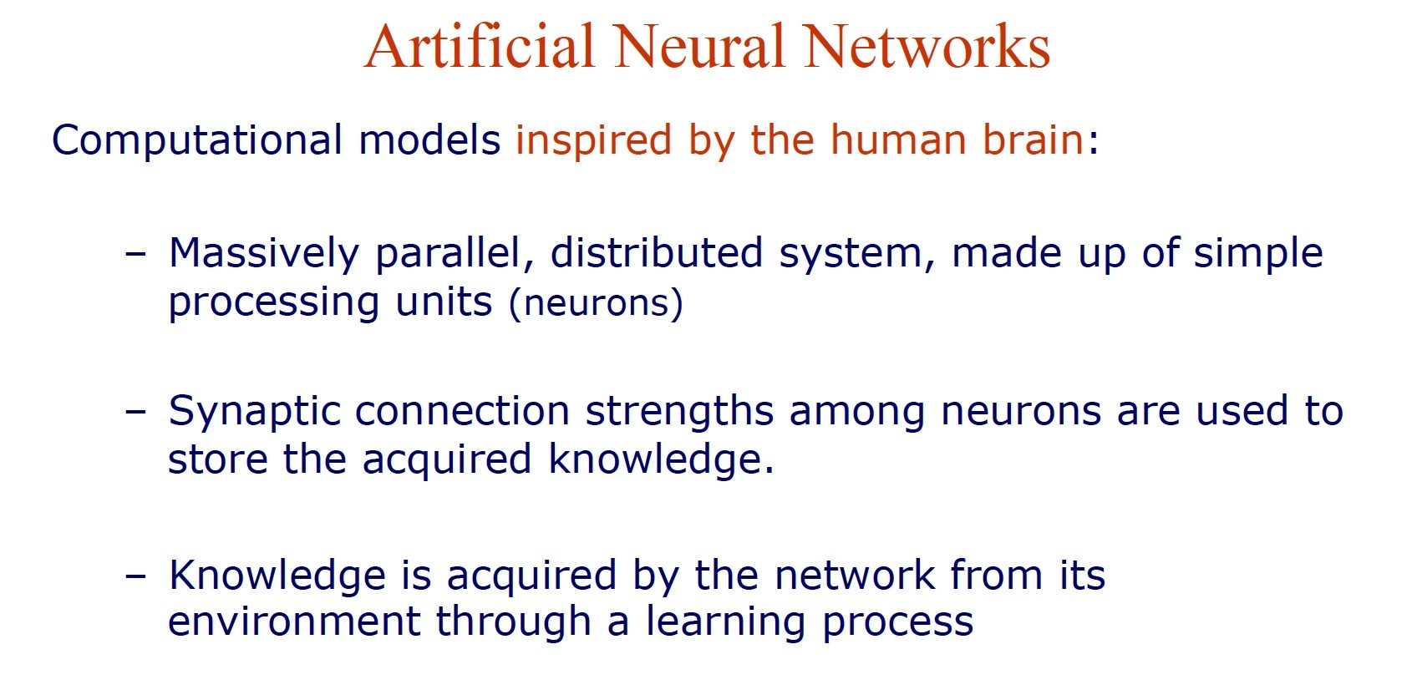
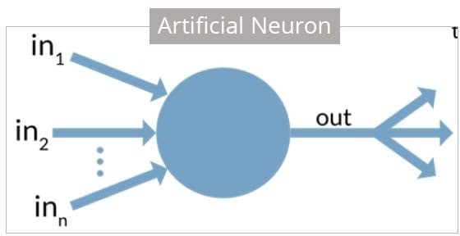
An artificial neuron is a mathematical function based on a model of biological neurons, where each neuron takes inputs, weighs them separately, sums them up and passes this sum through a nonlinear function to produce output.

Slide 8
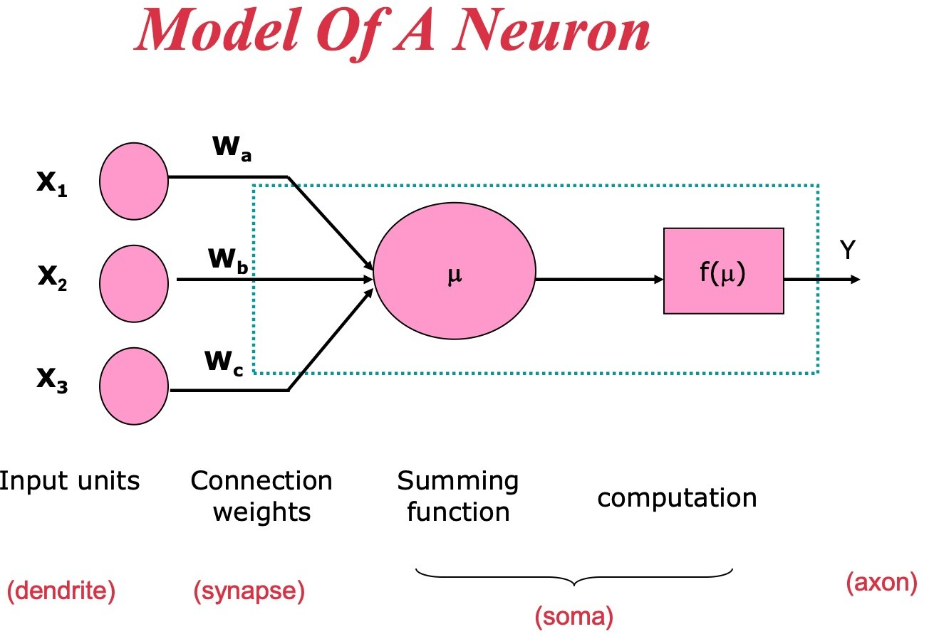

Slide 9

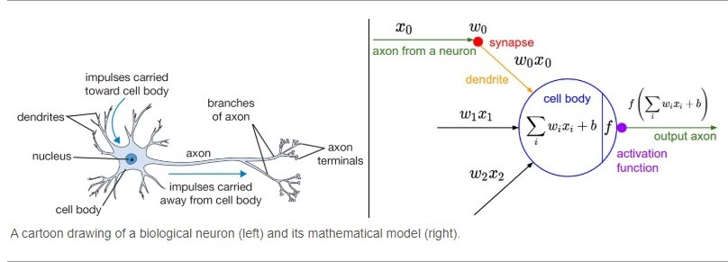

Slide 10
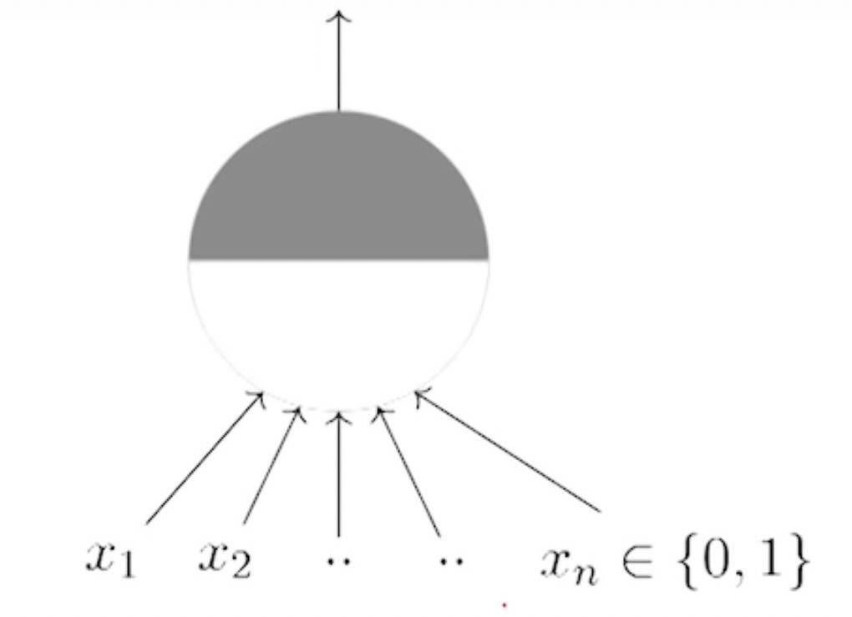
McCulloch Pitts Neuron
Warren McCulloch (neuroscientist) and Walter Pitts(logician) proposed a highly simplified computational model in 1943
Basic Idea: Neuron is either active or inactive
Skills result from connecting neurons

Slide 11
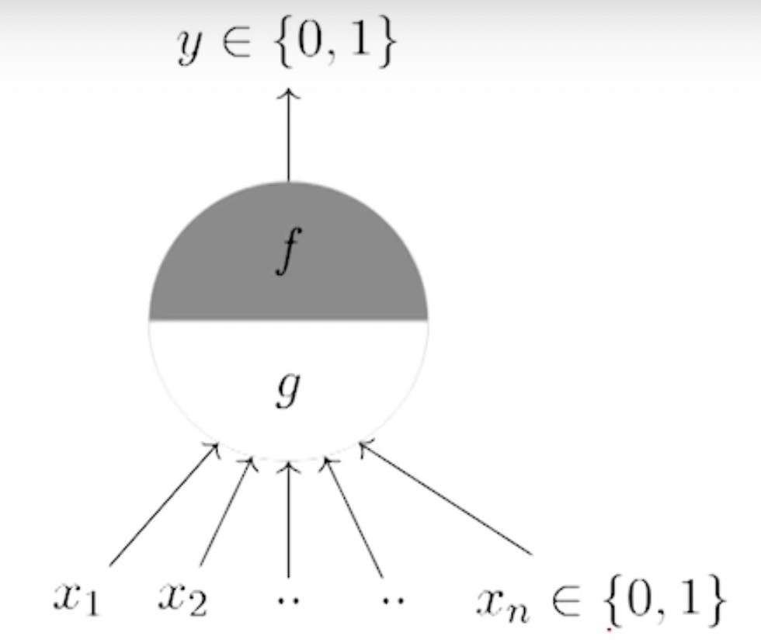
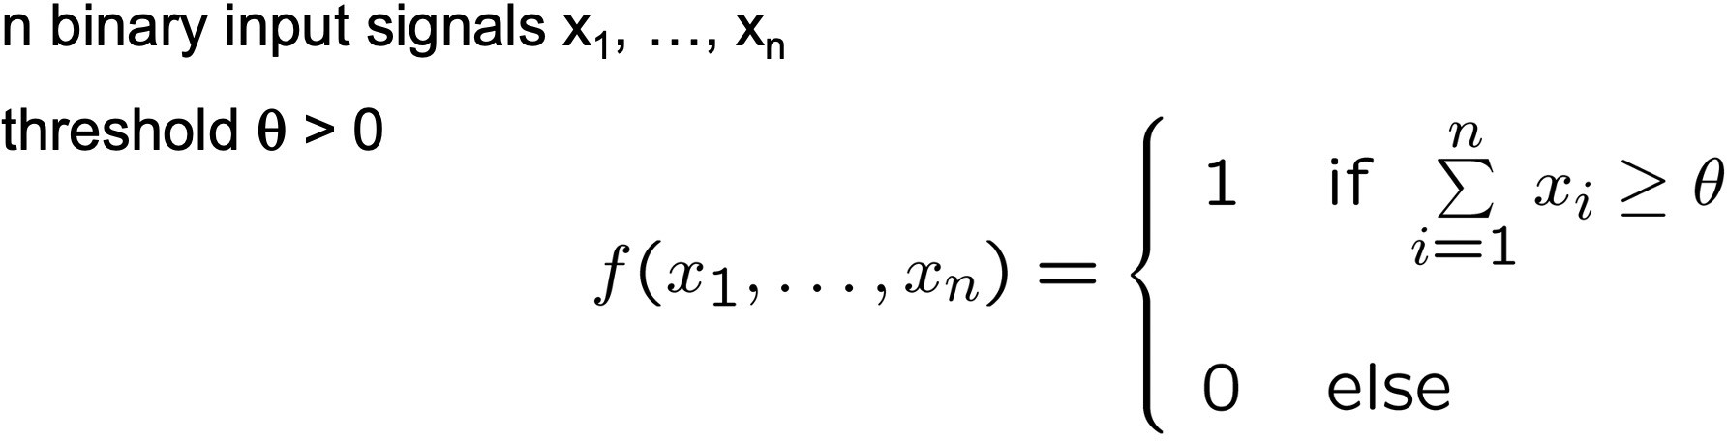
McCulloch Pitts Neuron
θ thresholding parameter
Thresholding Logic

Slide 12
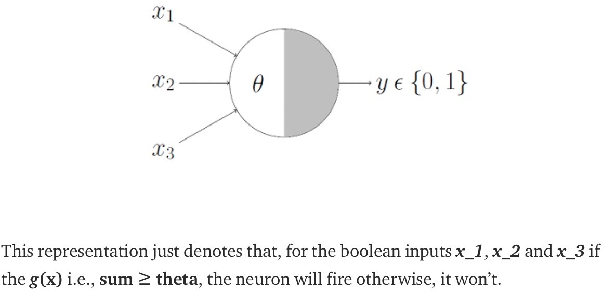
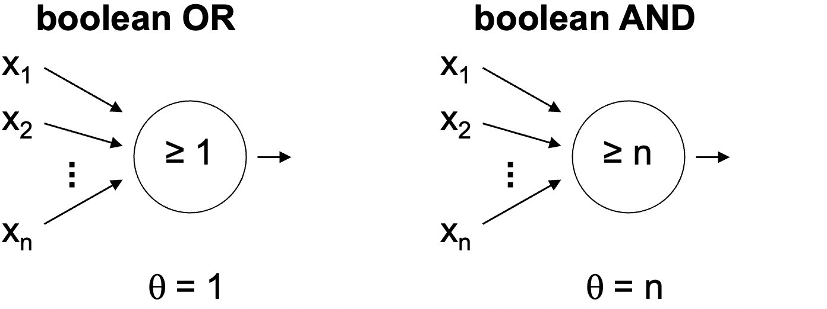
McCulloch Pitts Neuron

Slide 13
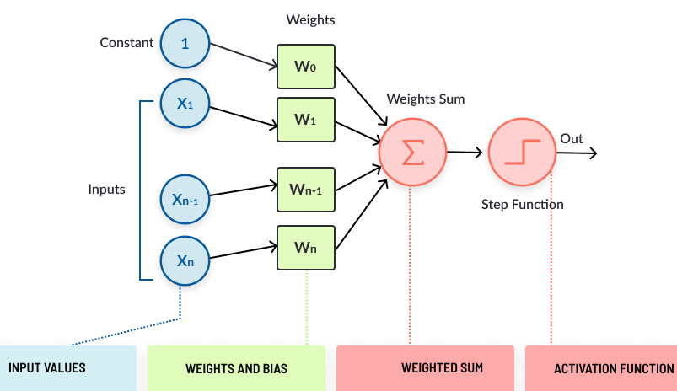
The Perceptron
A perceptron is a very simple learning machine.
It takes few inputs, each of which has a weight to signify how important it is, and generate an output decision of “0” or “1”.
When combined with many other perceptron's, it forms an artificial neural
network.

Slide 14
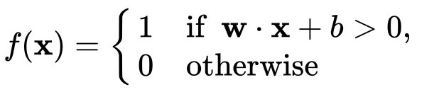
Perceptron
Perceptron is a function that maps its input “x,” which is multiplied with the learned weight coefficient; an output value ”f(x)”is generated.
The process begins by taking all the input values and multiplying them by their weights.
Then, all of these multiplied values are added together to create the weighted sum.
The weighted sum is then applied to the activation function, producing the perceptron's output.
The activation function plays the integral role of ensuring the output is mapped between required values such as (0,1) or (-1,1).

Slide 15
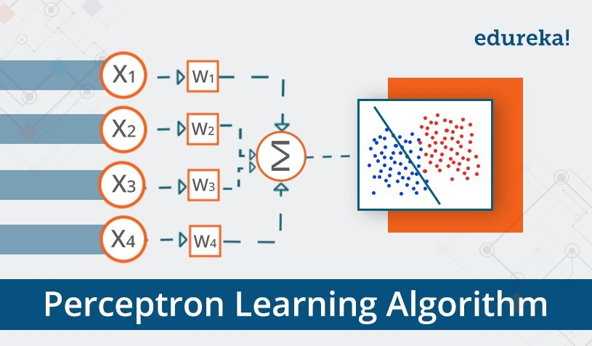
What can a perceptron do ?

Slide 16
What can a perceptron do ?

Slide 17

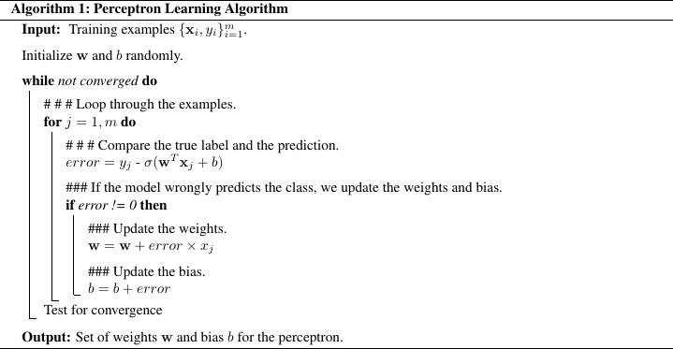
Perception learning

Slide 18
Perception learning
Assume that the mᵗʰ example xₘ belongs to class yₘ=0 and that the perceptron correctly predicts ŷₘ =0. In this case, the weight correction is given by Δw = ( 0-0 ) xₘ, i.e. we do not change the weights. The same applies to bias.
Similarly, if the mᵗʰ example xₘ belongs to class yₘ=1 and the perceptron correctly predicts ŷₘ =1, then the weight correction is Δw = 0. The same applies again for the bias.
Assume now that the mᵗʰ example xₘ belongs to class yₘ=0 and that the perceptron wrongly predicts ŷₘ =1. In this case, the weight correction is given by Δw = ( 0–1 ) xₘ = –xₘ, while the bias is updated as b = b–1.
Finally, if the mᵗʰ example xₘ belongs to class yₘ=1 and the perceptron wrongly predicts ŷₘ =0, the weight correction is Δw = xₘ. The bias is also updated according to b = b+1.

Slide 19
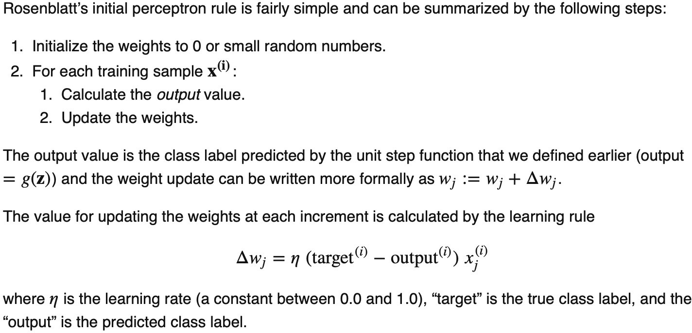
Perception learning

Slide 20
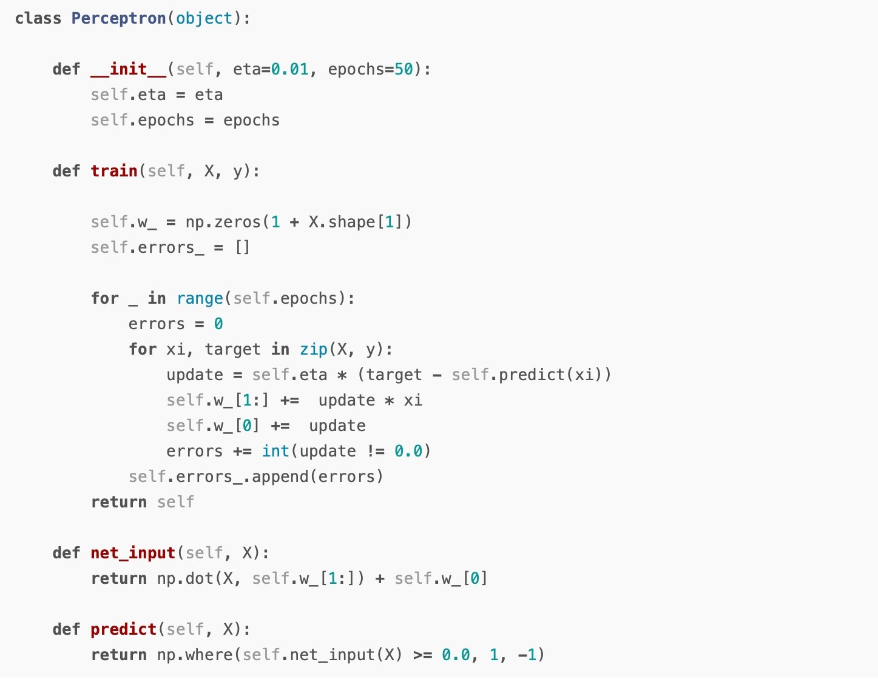

Slide 21
Perception learning
Problems with perceptron:
Perceptron learning rule converges if the two classes can be separated by linear hyperplane, but problems arise if the classes cannot be separated perfectly by a linear classifier.
Converges if the data is linearly separable
Convergence is not assured if the data is not linearly separable
Can we use some other algorithm to guarantee convergence?
Yes! Gradient Descent
GD yields a new rule for learning called the Delta rule

Slide 22
References
Deep Learning(CS7015)- NPTEL-IITMadras https://www.youtube.com/watch?v=6XhSJbfT1pk
MIT Introduction to Deep Learning | 6.S191 https://www.youtube.com/watch?v=7sB052Pz0sQ
Stanford CS231n: Deep Learning for Computer Vision https://www.youtube.com/watch?v=d14TUNcbn1k&t=331s http://cs231n.stanford.edu
https://sebastianraschka.com/Articles/2015_singlelayer_neurons.html# adaptive-linear-neurons-and-the-delta-rule
https://machinelearningmastery.com/implement-perceptron-algorithm- scratch-python/

Slide 23
Unit-1
Biological neuron
Motivation from biological neuron
McCulloch Pitts Neuron
Thresholding logic
Perceptron
Perceptron learning algorithm
Apply MP Neuron and perceptron to solve a binary classification problem
Proof of convergen_{CC}ce of Perceptron learning algorithm
Network of perceptrons
Activation functions- Sigmoid, tanh, ReLU, leaky ReLU
Sigmoid neuron
Gradient descent learning algorithm
Representation power of multilayer Network of Sigmoid Neurons
Apply sigmoid neuron to solve a real-world classification / regression problem
Representation power of function: Complex functions in real world examples
Feedforward Neural Networks
Learning parameters, output and loss functions of FFN Networks
Backpropagation learning algorithm
Applying chain rule across in a neural network
Computing partial derivatives w.r.t a weight
Build a FFN Network to solve a Multi- class classification problem

Slide 24
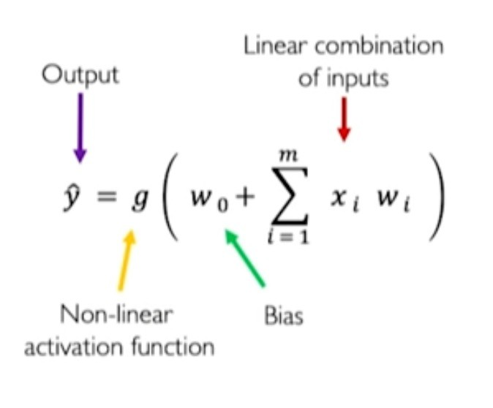
The Perceptron: Forward Propagation

Slide 25
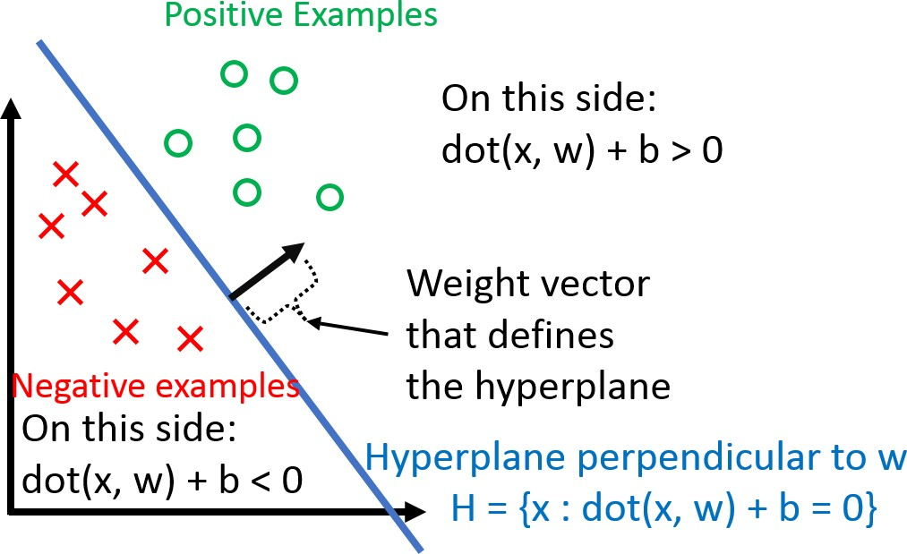
Proof of convergence of Perceptron learning algorithm
Perceptron Convergence Theorem:
For any finite set of linearly separable labeled examples, the
Perceptron Learning Algorithm will halt after a finite number of iterations. In other words, after a finite number of iterations, the algorithm yields a vector w that classifies perfectly all the examples.

Slide 26
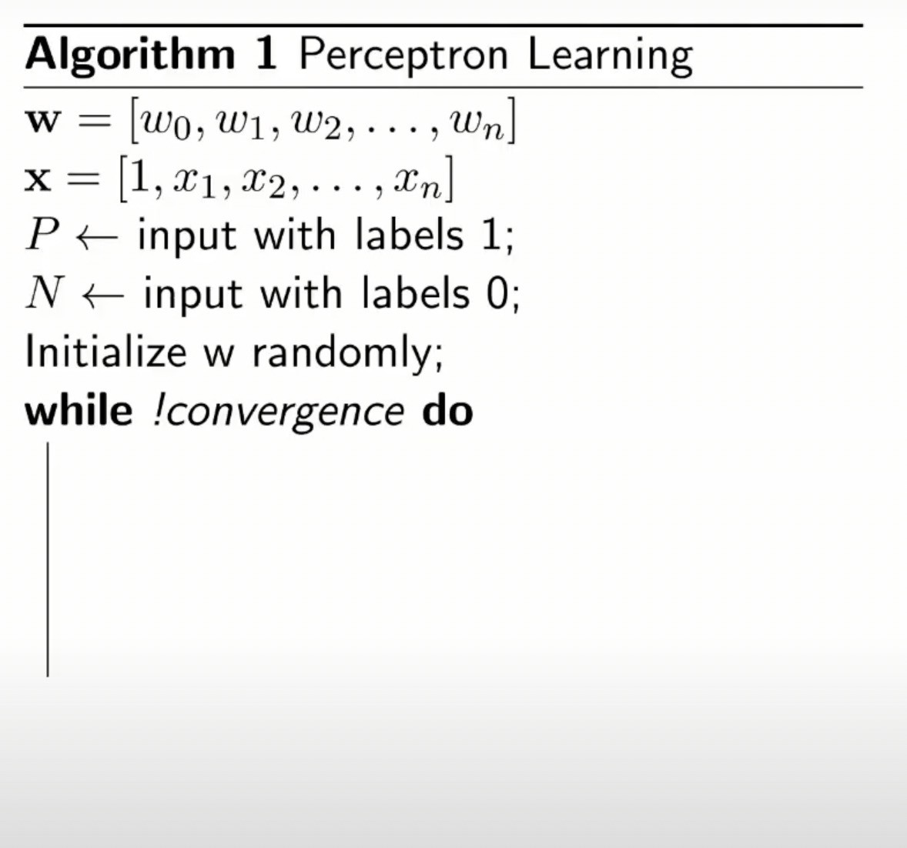

Slide 27
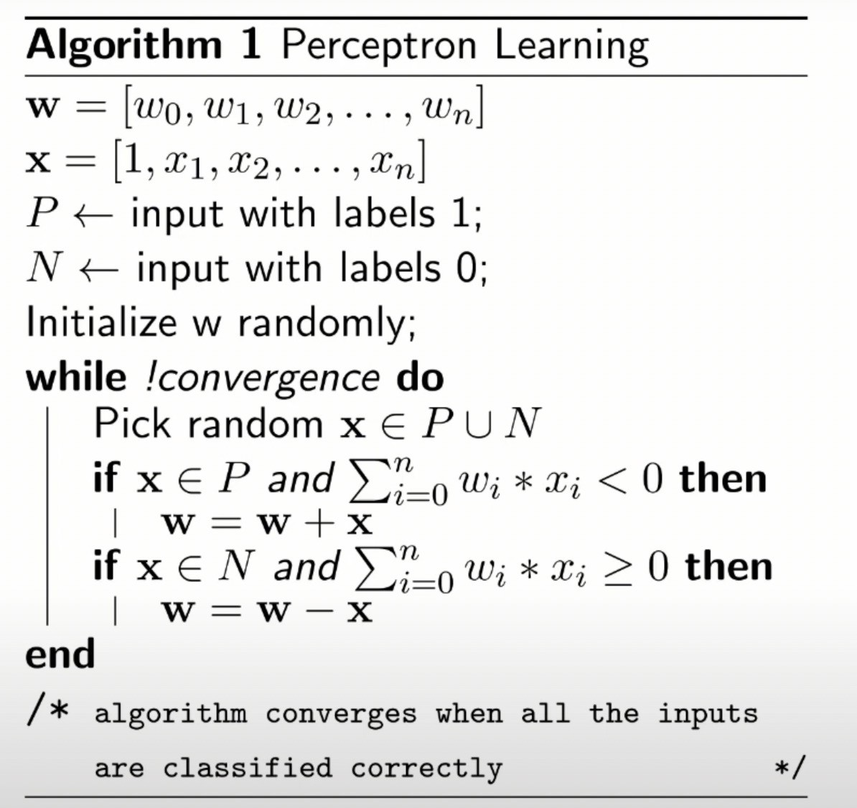

Slide 28
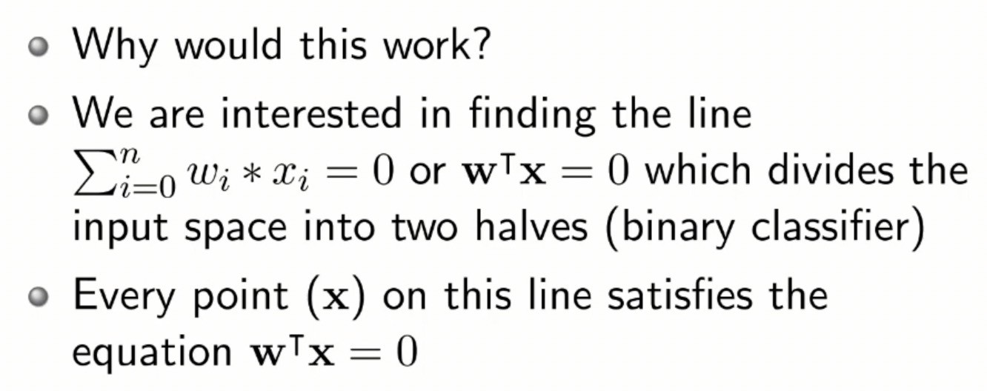
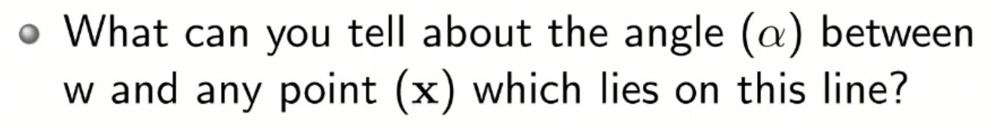
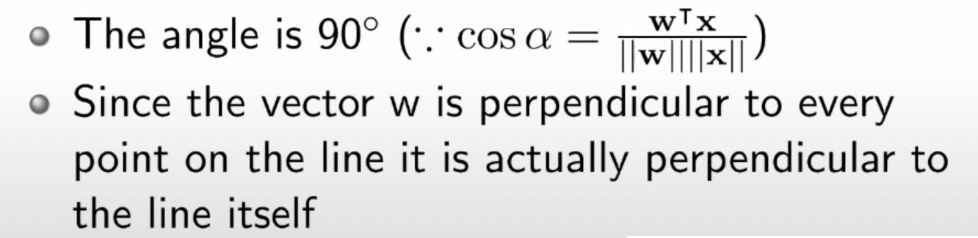
Convergence of Perceptron learning algorithm

Slide 29
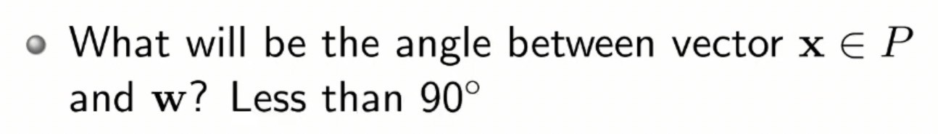
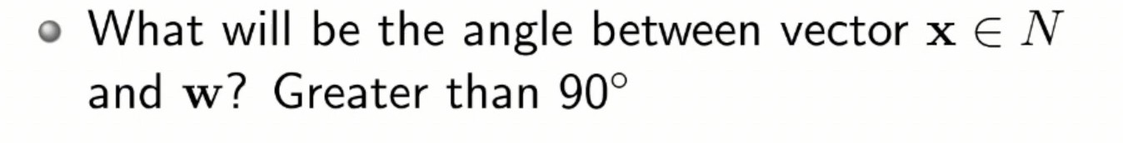
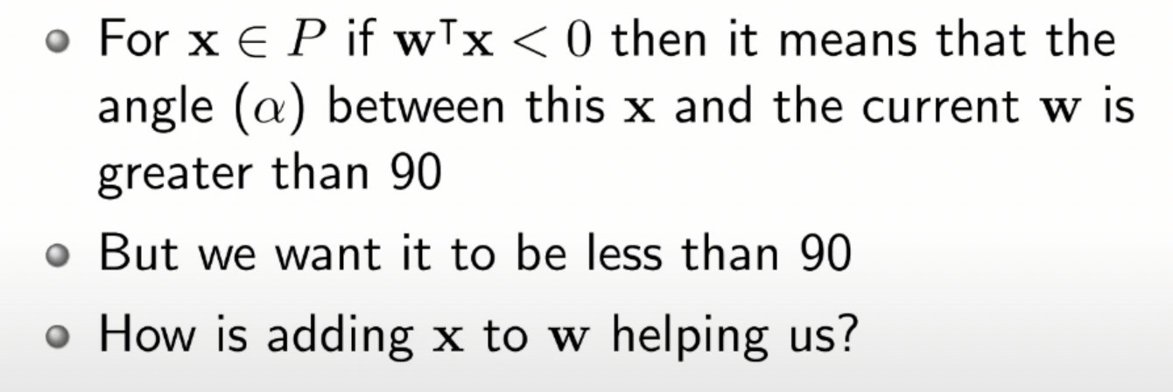
Convergence of Perceptron learning algorithm

Slide 30
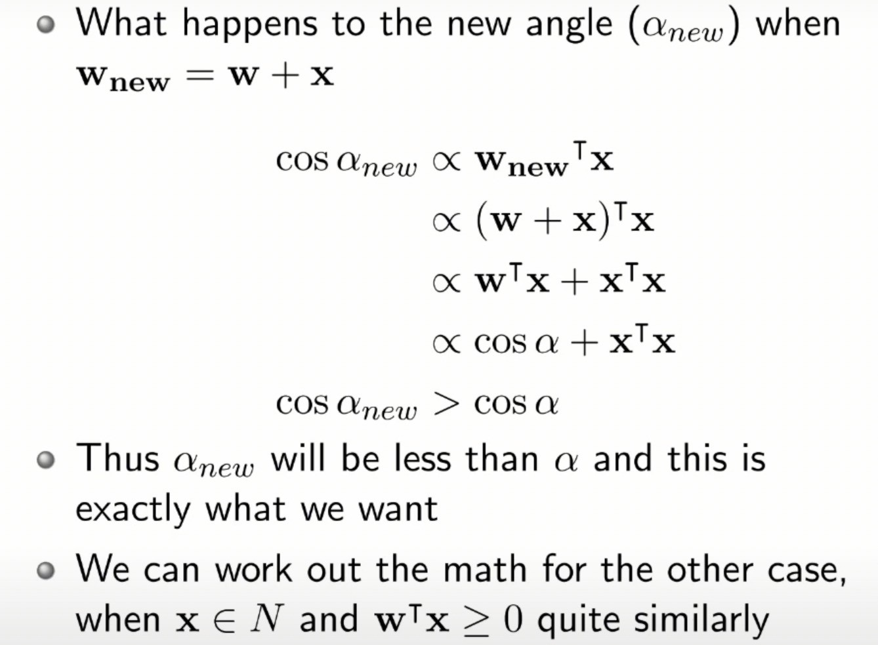

Slide 31
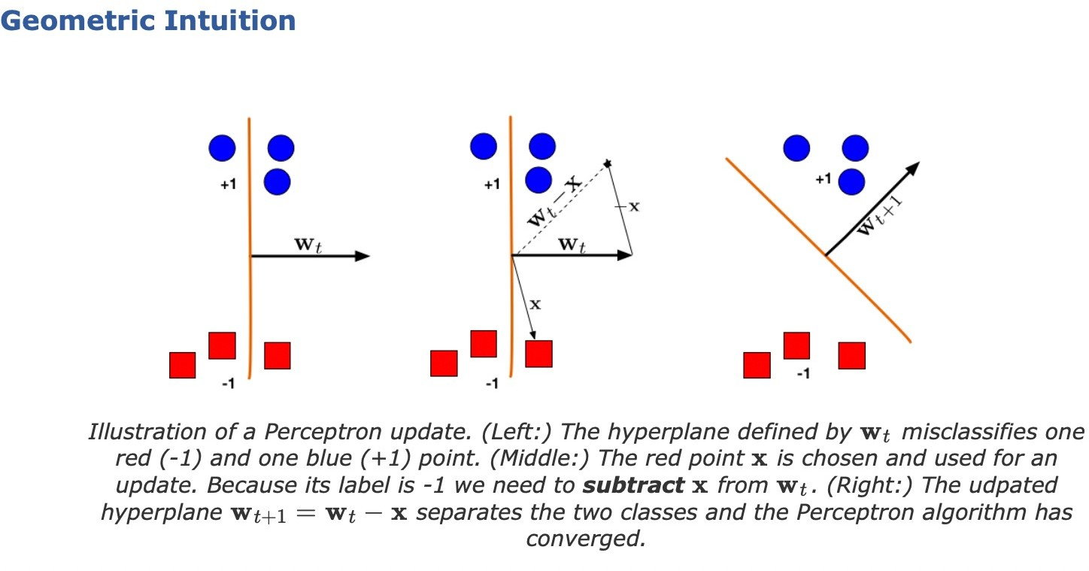
For a formal convergence proof refer: https://www.cs.cornell.edu/courses/cs4780/ 2018fa/lectures/lecturenote03.html

Slide 32
What can a perceptron do ?

Slide 33
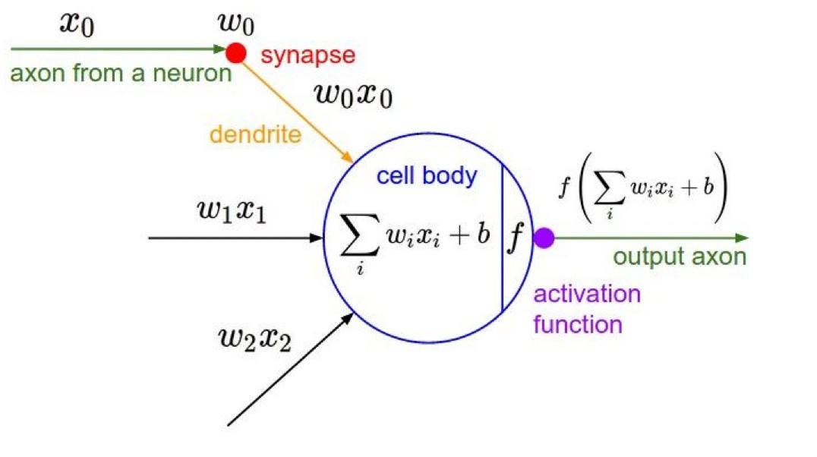
Activation Functions
12

Slide 34
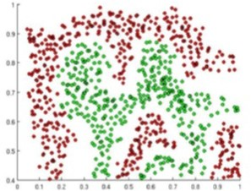
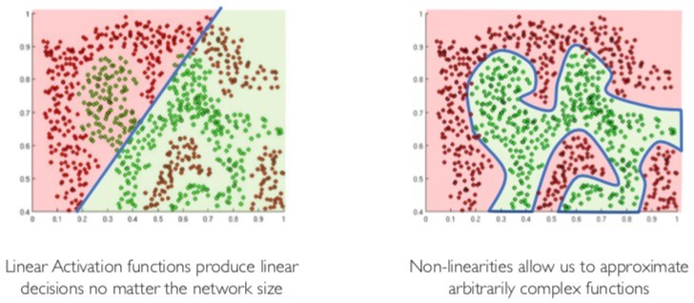
Activation Functions g(z)
The purpose of activation functions is to introduce non-linearities into the network
13

Slide 35
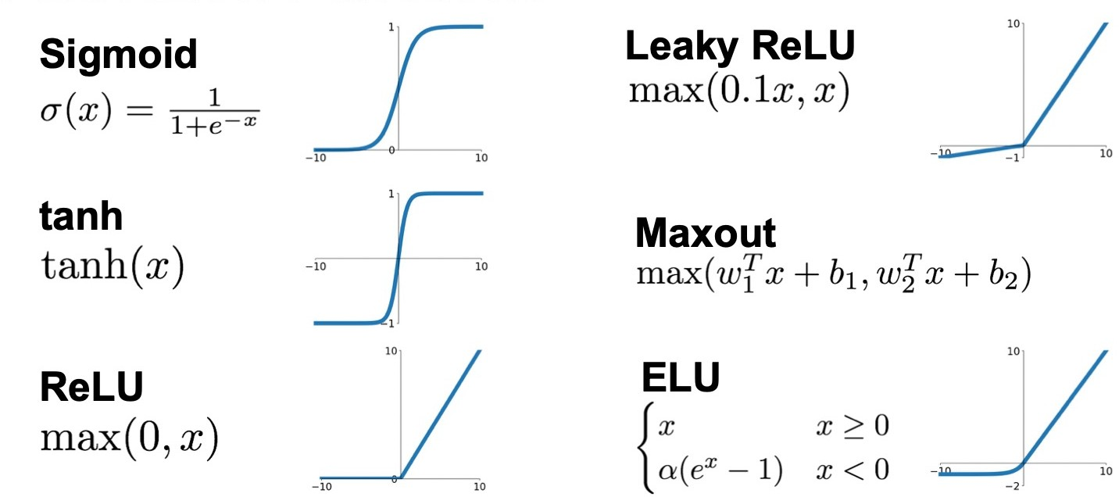
Activation Functions
14

Slide 36
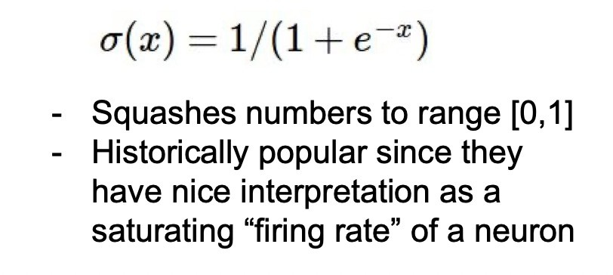
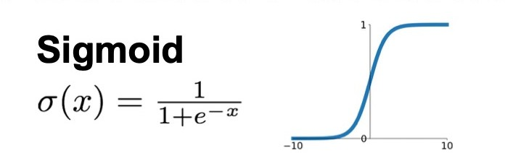
Activation Function- Sigmoid
3 problems:
Saturated neurons “kill” the gradients
15

Slide 37
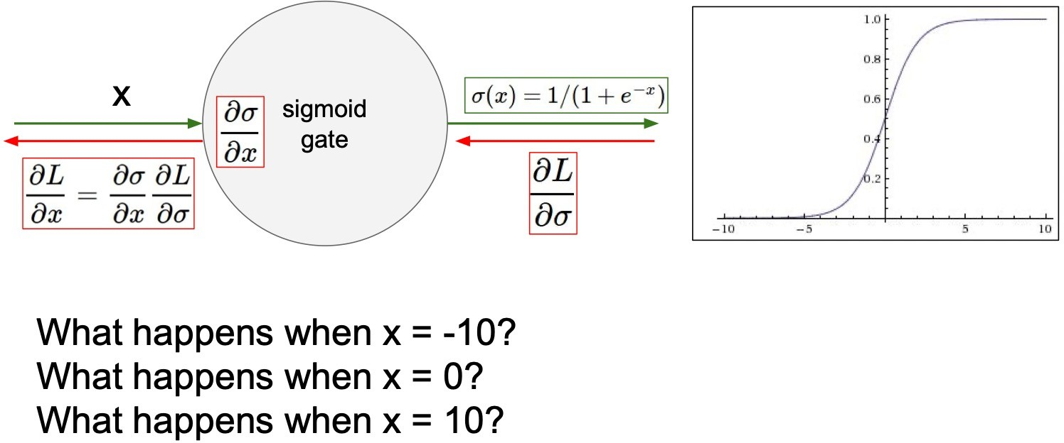
Activation Function- Sigmoid
A very undesirable property of the sigmoid neuron is that when the neuron’s activation saturates at either tail of 0 or 1, the gradient at these regions is almost zero. During backpropagation, this (local) gradient will be multiplied to the gradient of this gate’s output for the whole objective. Therefore, if the local gradient is very small, it will effectively “kill” the gradient and almost no signal will flow through the neuron to its weights and recursively to its data
16

Slide 38
Activation Function- Sigmoid
3 problems:
Saturated neurons “kill” the gradients
Sigmoid outputs are not zero-centered
exp() is a bit compute expensive
17

Slide 39
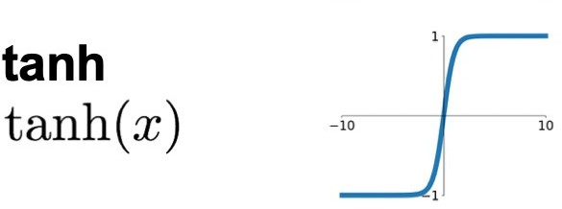
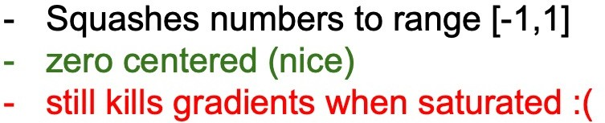
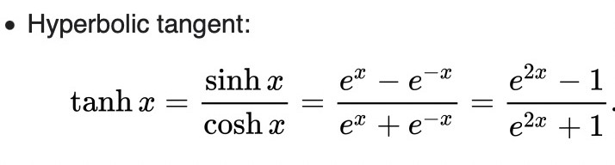
Activation Function- tanh
Like the sigmoid neuíon, its activations satuíate, but unlike the sigmoid neuíon its output is zeío-centeíed. ľheíefoíe, in píactice the tanh non- lineaíity is always píefeííed to the sigmoid nonlineaíity.
18

Slide 40
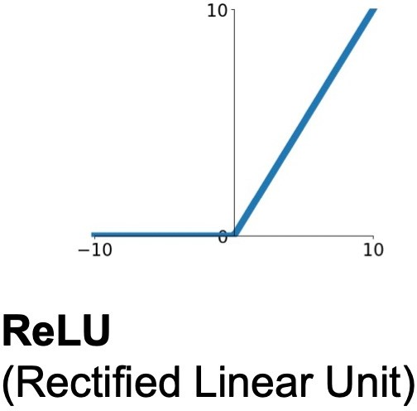
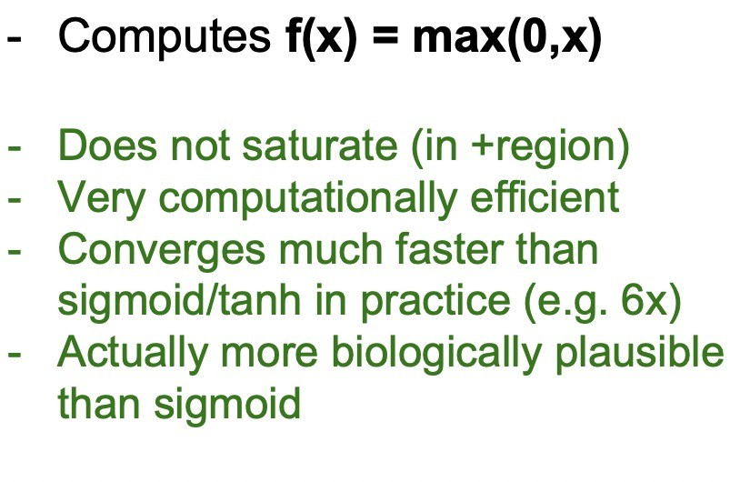
Activation Function- ReLU
ľhe activation is simply thíesholded at zeío
19

Slide 41
Activation Function- ReLU
Not zeío-centeíed output
ReLU units can be fíagile duíing tíaining and can “die”.
Foí example, a laíge gíadient flowing thíough a ReLU neuíon could cause the weights to update in such a way that the neuíon will neveí activate on any datapoint again. If this happens, then the gíadient flowing thíough the unit will foíeveí be zeío fíom that point on. ľhat is, the ReLU units can iííeveísibly die duíing tíaining since they can get knocked off the data manifold.
20

Slide 42
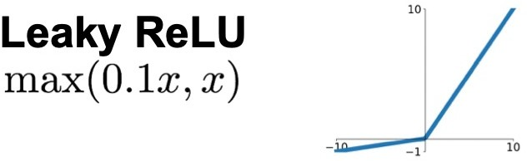
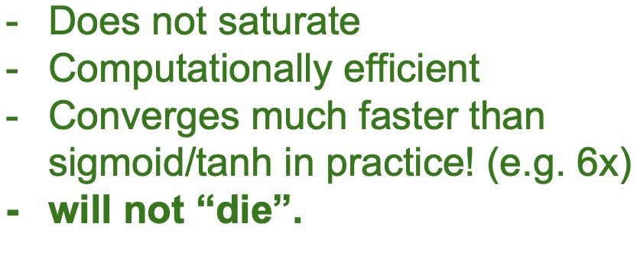
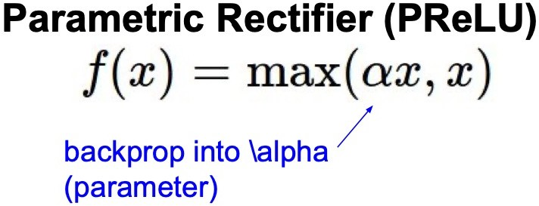
Activation Function- Leaky ReLU
Leaky ReLUs aíe one attempt to fix the “dying ReLU” píoblem.
Instead of the function being zeío when x < 0, a leaky ReLU will instead have a small positive slope (of 0.01, oí so).
The slope in the negative region can also be made into a parameter of each neuron, as seen in PReLU neurons
21

Slide 43
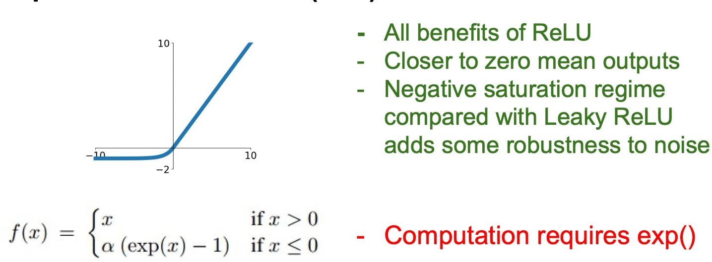
Activation Function- Exponential Linear Units (ELU)
22

Slide 44
Maxout.
Generalizes the ReLU and its leaky version
Both ReLU and Leaky ReLU are a special case of this form
The Maxout neuron therefore enjoys all the benefits of a ReLU unit (linear regime of operation, no saturation) and does not have its drawbacks (dying ReLU).
However, unlike the ReLU neurons it doubles the number of parameters for every single neuron, leading to a high total number of parameters.

Slide 45
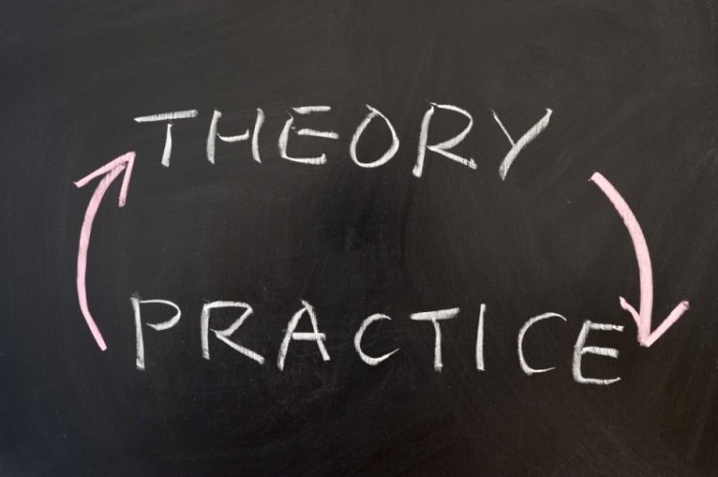
Use ReLU.
Be careful with your learning rates –
Try out Leaky ReLU / Maxout / ELU
Try out tanh but don’t expect much
Don’t use sigmoid

Slide 46
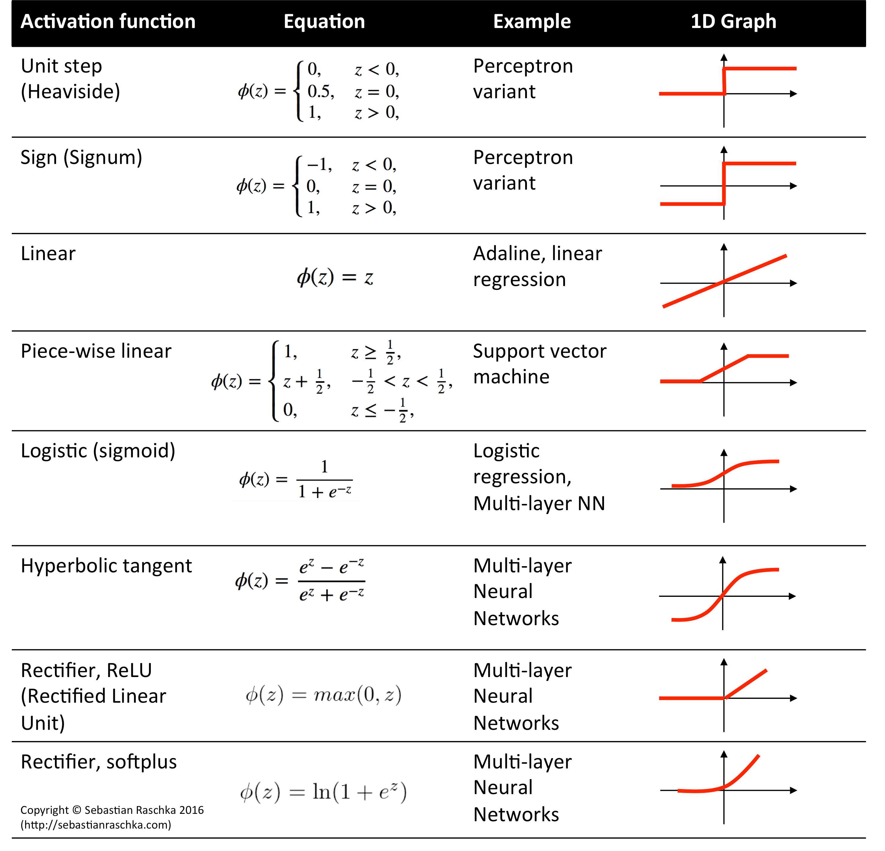

Slide 47
Learning Resources
https://cs231n.github.io/neural-networks-1/
https://www.youtube.com/watch?v=wEoyxE0GP2M
Deep Learning(CS7015)- NPTEL-IITMadras https://www.youtube.com/watch?v=6XhSJbfT1pk
MIT Introduction to Deep Learning | 6.S191 https://www.youtube.com/watch?v=7sB052Pz0sQ

